Slide 1

Hotel Management
THE GRAND

Slide 2
Project Proposal
Users in the Application
Following are the users of the Application
1-Admin
2-Site Visiting user
3-Registered user

Slide 3
Users Roles
Admin Roles
Access for all the pages and can perform CRUD operations like –
1-Add
2-View
3-Delete
4-Update

Slide 4
Users Roles
Visiting User Roles
View access for all the pages like
1-Home
2-About
3-Contact Us
*User can register on the Home page
*View access for About page
*Add access to Contact us page for sending any queries

Slide 5
Users Roles
Registered User Roles
1-Home
2-About
3-Booking
4-Restaurant
5-Contact Us
6-Reviews
7-Events
8-News
9-Location

Slide 6
Tech Stack
Tech Stack used are as follows :
1-SQLite [Database]
2-Django [Backend ]
3-HTML, CSS, JS, Bootstrap [Frontend]
4-draw.io [UML Designing]

Slide 7
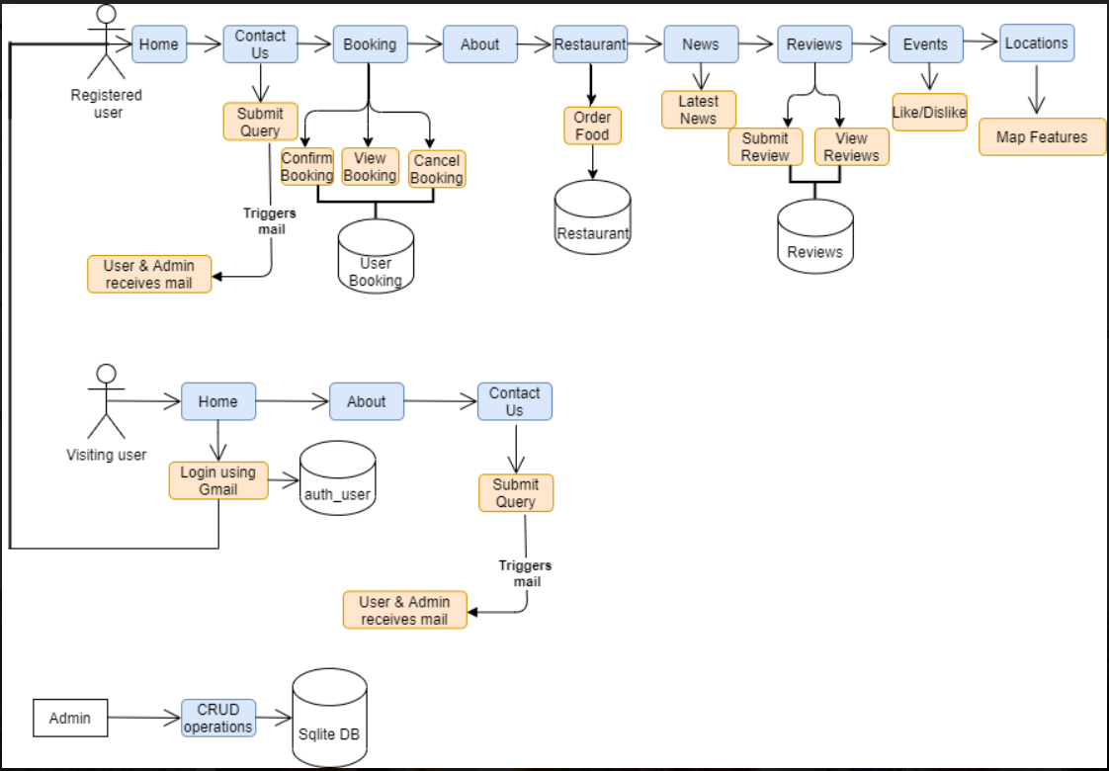
Activity Diagram

